Slide 1

Take Home Project for Data Analysis
Using Jupyter Notebook and Python libraries like – Pandas, NumPy and Matplotlib
Performed by
K. Polishchuk

Slide 2
1. Short Project Overview
For this project, you will interpret data from the National Parks Service about endangered species in different parks.
You will perform some data analysis on the conservation statuses of these species and investigate if there are any patterns or themes to the types of species that become endangered. During this project, you will analyze, clean up, and plot data as well as pose questions and seek to answer them in a meaningful way.
After you perform your analysis, you will share your findings about the National Park Service.
Project Objectives:
Complete a project to add to your portfolio
Use Jupyter Notebook to communicate findings
Run an analysis on a set of data
Become familiar with data analysis workflow
Prerequisites:
Data Visualization
Communicating Data Science Findings

Slide 3
2. Available Data.
The species_info.csv contains information on the different species in the USA National Parks. The columns in the data set include:
category - The class of animal
scientific_name - The scientific name of each species
common_names - The common names of each species
Conservation_status - Each species’ current conservation status
The observations.csv contains information about number of time each species are observed in the certain National Park. The columns in the data set include:
scientific_name - The scientific name of each species
park_name - Park where species were found
observations - The number of times each species was observed at park

Slide 4
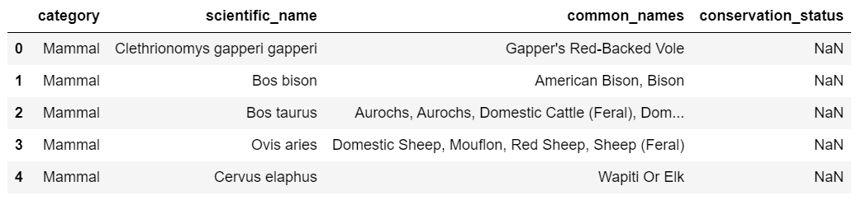

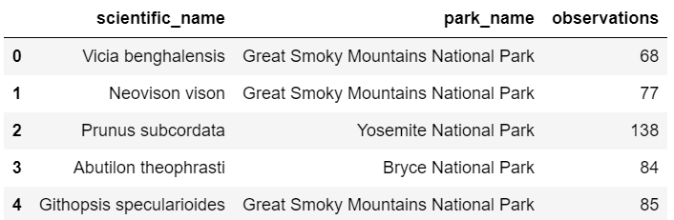
3. Summary of available information.
At first before starting any analysis we need to review the data base. Understand which tables, columns we have, and how those information related to each other. Calculate sum of species names and categories.

Slide 5
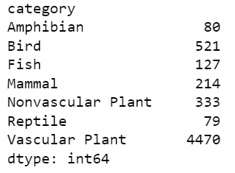
And one of the main questions of this project it is endangered species, how many, which species in which parks.

Slide 6
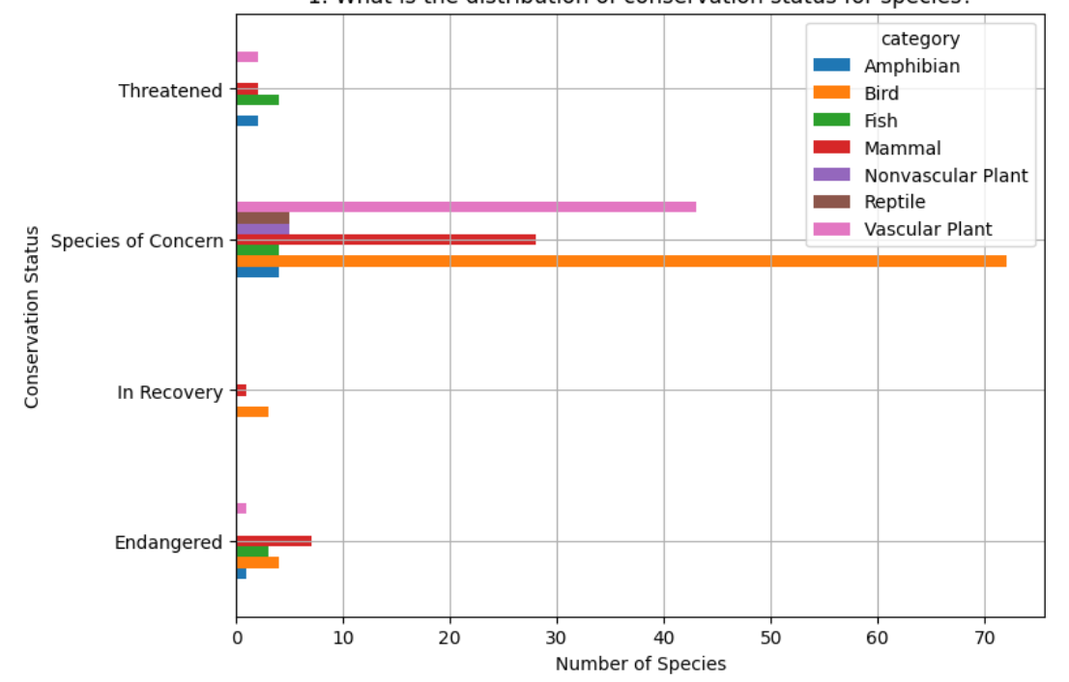
4. Graphs/ Tables for the visual analysis.
What is the distribution of conservation status for species?
Looking at this graph we can say which species is more endangered and approximate count.
Those numbers are summarized from all the parks depending on their conservation status.

Slide 7
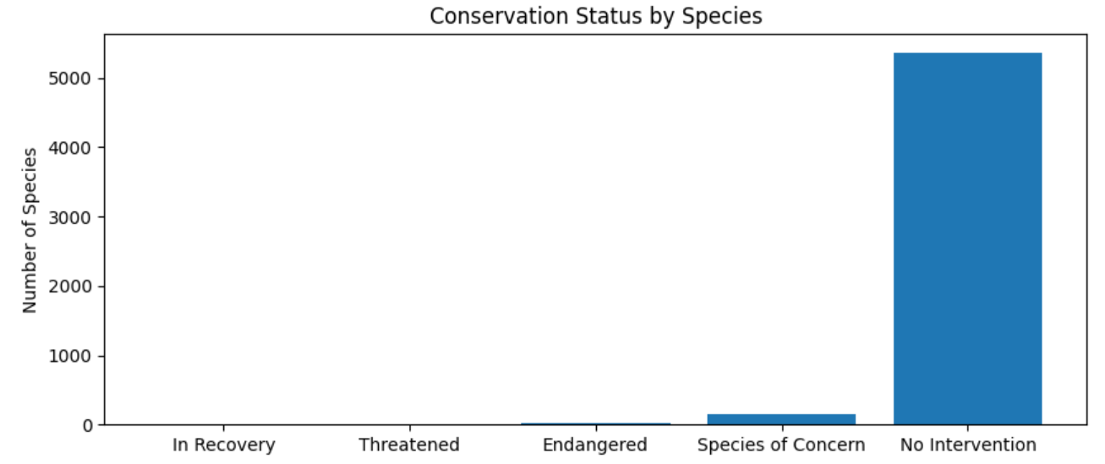
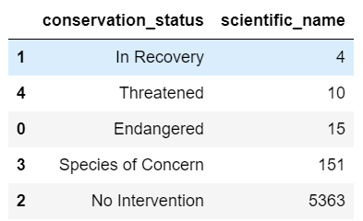
Are certain types of species more likely to be endangered?
For this question first we need to count how many unique species in each conservation status.
Those species, which doesn't have Conservation Status “No Intervention” - are not protected and might have higher chance to be endangered.

Slide 8
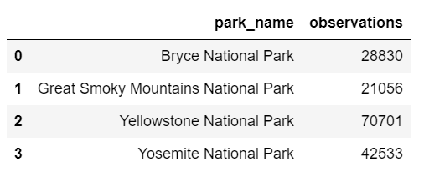
Which park has the highest and the lowest number of mammals ?
This question we visualized in the table view.
The table shows sum number of mammals in each park.
Yellowstone National Park has the highest and Great Smoky Mountains National Park has the lowest number of mammals.

Slide 9
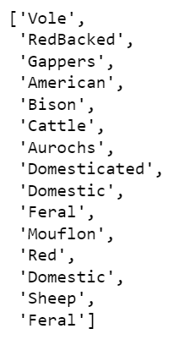
Which animal is most prevalent and what is their distribution amongst parks?
First, we have to look at the common names from species data frame to find the most prevalent animals in the dataset. If we look at common_names column of species, we can see that the data needs cleaning. We must clean it from punctuation and split it into separate words. After we need to drop duplicated names and combine all the list and count the frequency of each animal.

Slide 10
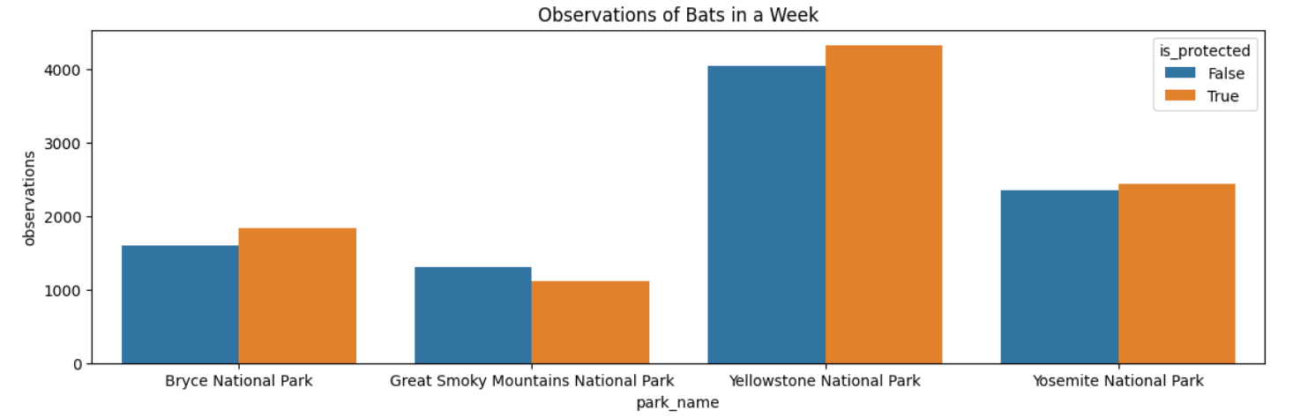
We can see that the most prevalent animal in the data set is bat. Since bats have different species with different scientific names, we must find out which rows of species are referring to bats.
Now let's see each park broken down by protected bats vs. non-protected bat sightings. This we can visualize in plotted bar chart.

Slide 11
5. Conclusions.
Technical analysis we can meet in everyday life and in any field. Those knowledge can be used in different circumstances.
Most important to understand the subject, main points and create a clear plan for analyzing data. As a data analysts we can understand the code, however, to show it to the clients – visualization plays a key part. This way we can show through graph, table or any other kind of plotting – the main points and answer on the question easier and more understandable way.
This project helped to practice on real numbers and run analysis. Work close in Jyputer notebook and learn more detailed some of python libraries, become familiar with data analysis workflow.

